Slide 1

BC2410, Prescriptive Analytics From Data to Decisions
A Brief Review of Lecture 9

Slide 2
Comments/Suggestions
Can you upload all the remaining slides for group projects reference?

Slide 3
On Group Project
Case study of an optimization problem
Report – At most 10 pages
Introduction
Model formulation
Analysis of solutions
Code in Jupyter Notebook
Model should be generic
Data must be read from a file or directly import from an online database
Presentation (Week 13)
Due for report submission: 17 April (Week 13)
Notes:
PLEASE DO NOT COPY!
Please do not submit a lengthy report. 10 pages for the main content.
Presentation accounts for 10 marks. Each of you need to present.

Slide 4
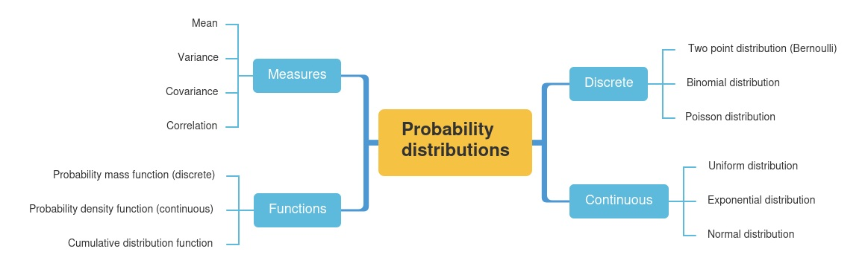

Probability Distribution

Slide 5
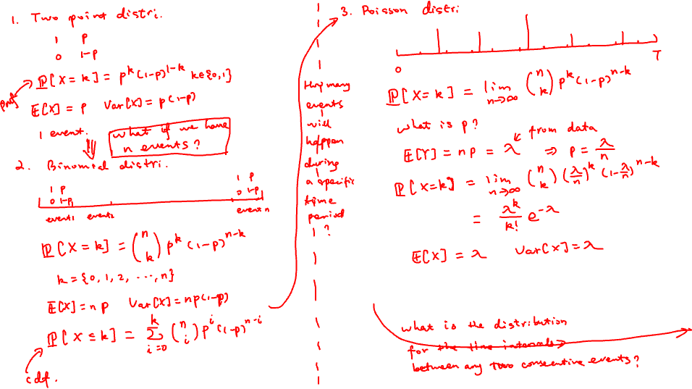

Slide 6
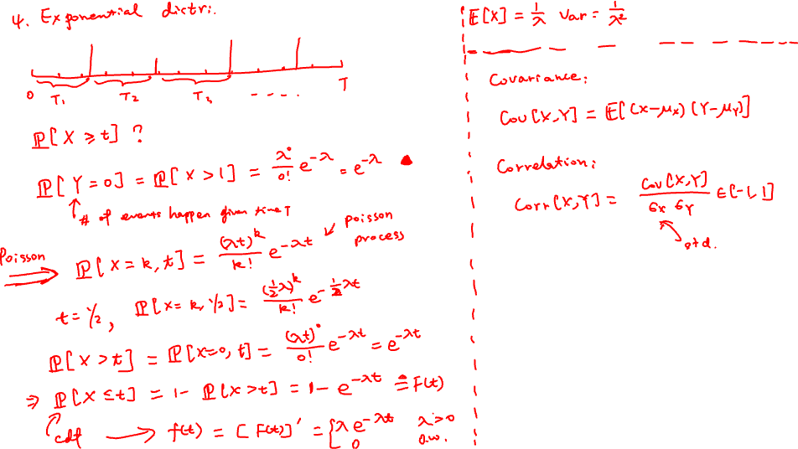

Slide 7
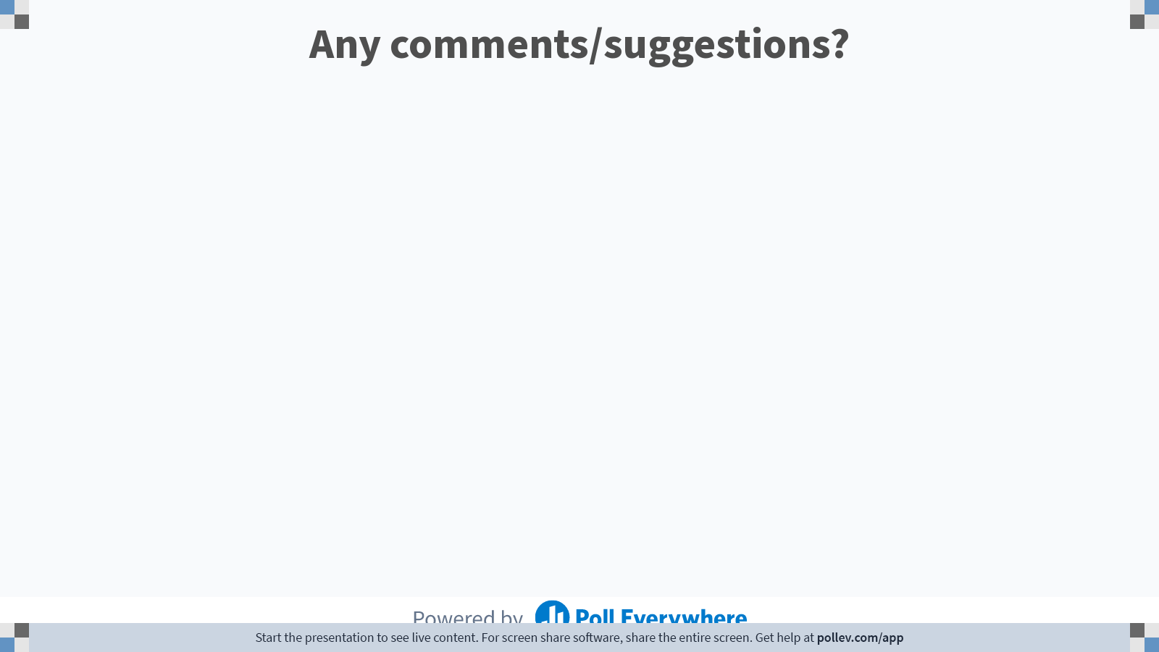
Notes:
Poll Title: Do not modify the notes in this section to avoid tampering with the Poll Everywhere activity. More info at polleverywhere.com/support Any comments/suggestions? https://www.polleverywhere.com/free_text_polls/aEgs6JdlgDIh5RJA5ExH1

